Slide 1
MASTERS IN PROJECT MANAGEMENT
PROJECT RISK
MANAGEMENT
Class: MS(PM)-2(A,B&C)

Slide 2
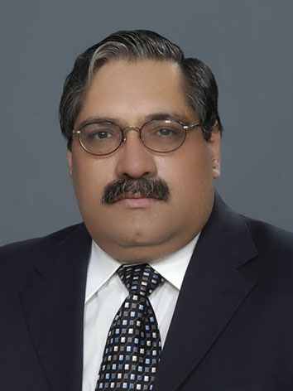
Instructor
Suhail Iqbal
PE, PMP, PgMP, PME, MCT, PRINCE2 Practitioner.
PE, PMP, PgMP, PME, MCT, PRINCE2 Practitioner.
Notes:
Custom animation effects: horizontal scrolling text
(Basic)
To reproduce the text effects on this slide, do the following:
On the Home tab, in the Slides group, click Layout, and then click Blank.
On the Insert tab, in the Text group, click Text Box, and then on the slide, drag to draw the text box.
Enter text in the text box. (Note: You may want to add a bullet point at the end of your text, as in the example above. On the Insert tab, in the Text group, click Symbol. In the Symbol dialog box, in the Font list, select (normal text). In the Subset list, select General Punctuation. In the Character Code box, enter 2022 to select BULLET, and then click Insert.)
Select the text. On the Home tab, in the Font group, do the following:
In the Font list, select Gill Sans MT.
In the Font Size list, select 36.
Click Bold.
Click the arrow next to Font Color, and then under Theme Colors click White, Background 1 (first row, first option from the left).
On the Home tab, in the Paragraph group, click Align Text Left to align the text left in the text box. (Note: If the text wraps to more than one line, drag the adjustment handles on the text box to widen it until the text fits on one line.)
Drag the text box to the left of the lower left edge of the slide. (Note: To see beyond the edges of the slide, on the View tab, click Zoom, and then in the Zoom dialog box, in the Percent box, enter 40%.)
To reproduce the animation effects on this slide, do the following:
On the Animations tab, in the Animations group, click Custom Animation.
On the slide, select the text box. In the Custom Animation task pane, do the following:
Click Add Effect, point to Entrance, and then click More Effects. In the Add Entrance Effect dialog box, under Basic, click Fly In.
Select the animation effect (fly-in effect for the text box). Click the arrow to the right of the select effect, and then click Effect Options. In the Fly In dialog box, do the following:
On the Effect tab, in the Direction list, select From Right.
On the Timing tab, do the following:
In the Start list, select With Previous.
In the Speed box, enter 16 seconds.
In the Repeat list, select Until End of Slide.
On the slide, select the text box. On the Home tab, in the Clipboard group, click the arrow under Paste, and then click Duplicate.
In the Custom Animation task pane, select the second animation effect (fly-in effect for the second text box). Click the arrow to the right of the selected effect, and then click Timing. In the Fly In dialog box, on the Timing tab, in the Delay box, enter 8. (Note: You may need to adjust the delay time if the length of your text is different than the example above.)
On the slide, drag the second text box on top of the first text box.
On the Home tab, in the Editing group, click Select, and then click Selection Pane.
In the Selection and Visibility pane, press and hold CTRL, and then select both text boxes. On the Home tab, in the Drawing group, click Arrange, point to Align, and then do the following:
Click Align Selected Objects.
Click Align Middle.
Click Align Center.
To reproduce the background effects on this slide, do the following:
Right-click the slide background area, and then click Format Background. In the Format Background dialog box, click Fill in the left pane, and then select Picture or texture fill in the Fill pane. Under Insert from, click File. In the Insert Picture dialog box, select a picture, and then click Insert.
On the Home tab, in the Drawing group, click Shapes, and then under Rectangles click Rectangle (first option from the left). On the slide, drag to draw a rectangle.
Select the rectangle. Under Drawing Tools, on the Format tab, in the Size group, do the following:
In the Shape Height box, enter 7.5”.
In the Shape Width box, enter 1”.
Under Drawing Tools, on the Format tab, in the Shape Styles group, click the arrow next to Shape Outline, and then click No Outline.
On the Home Tab, in the Drawing group, click the arrow next to Shape Fill, point to Gradient, and then click More Gradients. In the Format Shape dialog box, click Fill in the left pane, select Gradient fill in the Fill pane, and then do the following:
In the Type list, select Linear.
Click the button next to Direction, and then click Linear Right (first row, fourth option from the left).
Under Gradient stops, click Add or Remove until two stops appear in the drop-down list.
Also under Gradient stops, customize the gradient stops that you added as follows:
Select Stop 1 from the list, and then do the following:
In the Stop position box, enter 0%.
Click the button next to Color, and then under Theme Colors click Black, Text 1 (first row, second option from the left).
In the Transparency box, enter 0%.
Select Stop 2 from the list, and then do the following:
In the Stop position box, enter 100%.
Click the button next to Color, and then under Theme Colors click Black, Text 1, (first row, second option from the left).
In the Transparency box, enter 100%.
On the slide, select the rectangle. On the Home tab, in the Drawing group, click Arrange, point to Align, and then do the following:
Click Align to Slide.
Click Align Left.
Click Align Middle.
Select the rectangle. On the Home tab, in the Clipboard group, click the arrow under Paste, and then click Duplicate.
Select the duplicate rectangle. On the Home Tab, in the Drawing group, click the arrow next to Shape Fill, point to Gradient, and then click Linear Left (second row, third option from the left).
With the duplicate rectangle still selected, on the Home tab, in the Drawing group, click Arrange, point to Align, and then do the following:
Click Align to Slide.
Click Align Right.
Click Align Middle.

Slide 3
SYLLABUS
Unit | Content | Learning Objectives
Principles & Concepts | Definition of Project Risk Individual Risks and Overall Project Risk The Natural Project Risk Management Sequence Risk Management – An Integrative Function Stakeholder Risk Attitudes Variations of Risk Factors Through the Project Life Cycle Four-Phase Approach Iterative Process Communication Responsibility for Project Risk Management Project Manager’s Role for Project Risk Management | Understand various principles and concepts involved in Project Risk Management specifically indicating various roles and responsibilities of Stakeholders and Project Manager

Slide 4
UNIT 4
UNIT 4
PRINCIPLES AND CONCEPTS
PROJECT RISK
MANAGEMENT
Class: MS(PM)-2(A,B&C)

Slide 5
PRINCIPLES AND CONCEPTS
LEARNING OBJECTIVE
UNIT 4
Understand various principles and concepts involved in Project Risk Management specifically indicating various roles and responsibilities of Stakeholders and Project Manager
Notes:
PRINCIPLES AND CONCEPTS
LEARNING OBJECTIVE
Understand various principles and concepts involved in Project Risk Management specifically indicating various roles and responsibilities of Stakeholders and Project Manager

Slide 6
PRINCIPLES AND CONCEPTS
CONTENT
UNIT 4
Definition of Project Risk
Individual Risks and Overall Project Risk
The Natural Project Risk Management Sequence
Risk Management – An Integrative Function
Stakeholder Risk Attitudes
Variations of Risk Factors Through the Project Life Cycle
Four-Phase Approach
Iterative Process
Communication
Responsibility for Project Risk Management
Project Manager’s Role for Project Risk Management
Notes:
PRINCIPLES AND CONCEPTS
CONTENT
Definition of Project Risk
Individual Risks and Overall Project Risk
The Natural Project Risk Management Sequence
Risk Management – An Integrative Function
Stakeholder Risk Attitudes
Variations of Risk Factors Through the Project Life Cycle
Four-Phase Approach
Iterative Process
Communication
Responsibility for Project Risk Management
Project Manager’s Role for Project Risk Management

Slide 7
PRINCIPLES AND CONCEPTS
Project Risk
Project Objectives
UNIT 4
“Project Risk is an uncertain event or condition that, if it occurs, has a positive or negative effect on the project objectives.”
“Project Risk is the cumulative effect of the chances of uncertain occurrences adversely affecting project objectives.”
Project objectives include:-
Scope
Schedule
Cost
Quality
From A Guide to Project Management Body of Knowledge (PMBOK®), 4th Ed, PMI
From Project and Program Risk Management, Max Wideman, PMI
Notes:
PRINCIPLES AND CONCEPTS
Project Risk
“Project Risk is an uncertain event or condition that, if it occurs, has a positive or negative effect on the project objectives.”
“Project Risk is the cumulative effect of the chances of uncertain occurrences adversely affecting project objectives.”
Project Objectives
Project objectives include:-
Scope
Schedule
Cost
Quality

Slide 8
PRINCIPLES AND CONCEPTS
Risk Dimensions
UNIT 4
Uncertainty – Probability or Likelihood
Clearly described
Less specific
Effect – Impact or Consequence
Negative Effect – Threats
may be called Issues or Problems
Positive Effect - Opportunities may be called Benefits
From A Guide to Project Management Body of Knowledge (PMBOK®), 4th Ed, PMI
Notes:
PRINCIPLES AND CONCEPTS
Risk Dimensions
Uncertainty – Probability or Likelihood
Clearly described
Less specific
Effect – Impact or Consequence
Negative Effect – Threats
may be called Issues or Problems
Positive Effect - Opportunities may be called Benefits

Slide 9
PRINCIPLES AND CONCEPTS
Cause and Effect
UNIT 4
Cause – Events or circumstances which currently exist or are certain to exist in the future and which might give rise to risks. Effect – Conditional future events or conditions which would directly affect one or more project objectives if the associated risk occurs.
Cause-Risk-Effect Chain can be used in a structured risk statement or risk description to ensure that each of these three elements is properly described.
From Practice Standard for Project Risk Management, 1st Ed, PMI
Notes:
PRINCIPLES AND CONCEPTS
Cause and Effect
Cause – Events or circumstances which currently exist or are certain to exist in the future and which might give rise to risks. Effect – Conditional future events or conditions which would directly affect one or more project objectives if the associated risk occurs.
Cause-Risk-Effect Chain can be used in a structured risk statement or risk description to ensure that each of these three elements is properly described.

Slide 10
PRINCIPLES AND CONCEPTS
Occurrence and Scope
UNIT 4
When Risk Event occurs, it ceases to become Uncertain
Both Issues/Problems or Benefits entail project management actions that are outside the scope of Project Risk Management process.
From Practice Standard for Project Risk Management, 1st Ed, PMI
Notes:
PRINCIPLES AND CONCEPTS
Occurrence and Scope
When Risk Event occurs, it ceases to become Uncertain
Both Issues/Problems or Benefits entail project management actions that are outside the scope of Project Risk Management process.

Slide 11
PRINCIPLES AND CONCEPTS
Individual and Overall Project Risk
UNIT 4
Individual Risks
Specific Events or conditions that might affect project objectives
Overall Project Risk
Effect of uncertainty on the project as a whole.
More than the sum of individual risks on a project.
Represents exposure of stakeholders to the implications of variations in project outcome.
From Practice Standard for Project Risk Management, 1st Ed, PMI
Notes:
PRINCIPLES AND CONCEPTS
Individual and Overall Project Risk
Individual Risks
Specific Events or conditions that might affect project objectives
Overall Project Risk
Effect of uncertainty on the project as a whole.
More than the sum of individual risks on a project.
Represents exposure of stakeholders to the implications of variations in project outcome.

Slide 12
PRINCIPLES AND CONCEPTS
Overall Project Risk
UNIT 4
Important component of strategic decision making, program management, portfolio management, and project governance where investment are sanctioned or cancelled and priorities are set.
Necessary to set realistic targets for the cost and duration of a project.
Establishing the contingency reserve levels required to protect the project stakeholders.
Set appropriate project priorities.
Judge whether the risk of overall success is increasing or decreasing as implementation advances.
From Practice Standard for Project Risk Management, 1st Ed, PMI
Notes:
PRINCIPLES AND CONCEPTS
Overall Project Risk
Important component of strategic decision making, program management, portfolio management, and project governance where investment are sanctioned or cancelled and priorities are set.
Necessary to set realistic targets for the cost and duration of a project.
Establishing the contingency reserve levels required to protect the project stakeholders.
Set appropriate project priorities.
Judge whether the risk of overall success is increasing or decreasing as implementation advances.

Slide 13
INTEGRATING RISK INTO PROJECT MANAGEMENT
UNIT 4
Poor Performance on Projects is attributed to:-
Unforeseen Events – which might or might not have been anticipated by more experienced project management.
Foreseen Events – for which risks have not been fully accommodated.
Management’s Attitude to Risk itself
Some have little understanding of the concepts
Others lack confidence in mathematical techniques and results obtained preferring to
aggressive risk taking or
undue caution
Inherent risks may simply be optimistically ignored.
From Project and Program Risk Management, Max Wideman, PMI
Notes:
INTEGRATING RISK INTO PROJECT MANAGEMENT
Poor Performance on Projects is attributed to:-
Unforeseen Events – which might or might not have been anticipated by more experienced project management.
Foreseen Events – for which risks have not been fully accommodated.
Management’s Attitude to Risk itself
Some have little understanding of the concepts
Others lack confidence in mathematical techniques and results obtained preferring to
aggressive risk taking or
undue caution
Inherent risks may simply be optimistically ignored.

Slide 14
THE NATURAL PROJECT
RISK MANAGEMENT SEQUENCE
UNIT 4
Concept Phase
Greatest degree of uncertainty
Change is an inevitable part of the iterative nature of managing projects
Yet its extent and effects are often under-estimated at this time
Need for a process for the realistic appraisal of factors affecting the accomplishment phases of the project is essential.
From Project and Program Risk Management, Max Wideman, PMI
Notes:
THE NATURAL PROJECT
RISK MANAGEMENT SEQUENCE
Concept Phase
Greatest degree of uncertainty
Change is an inevitable part of the iterative nature of managing projects
Yet its extent and effects are often under-estimated at this time
Need for a process for the realistic appraisal of factors affecting the accomplishment phases of the project is essential.

Slide 15
THE NATURAL PROJECT
RISK MANAGEMENT SEQUENCE
UNIT 4
Formal Process
Risks are systematically identified, assessed and provided for.
Involves deliberate sequence of identification, followed by mitigation.
Mitigation calls for assessment and response.
Defensive actions – Risk Avoidance or Deflection
Risk Assessment – detailed impact analysis, response planning and contingency planning
Alternative workarounds.
Budgeted contingency allowance
From Project and Program Risk Management, Max Wideman, PMI
Notes:
THE NATURAL PROJECT
RISK MANAGEMENT SEQUENCE
Formal Process
Risks are systematically identified, assessed and provided for.
Involves deliberate sequence of identification, followed by mitigation.
Mitigation calls for assessment and response.
Defensive actions – Risk Avoidance or Deflection
Risk Assessment – detailed impact analysis, response planning and contingency planning
Alternative workarounds.
Budgeted contingency allowance

Slide 16
THE NATURAL PROJECT
RISK MANAGEMENT SEQUENCE
UNIT 4
Formal Process
Uncertainties are numerous and interrelated
Affects project results in complex ways.
Tends to lead to under-estimation of risk
Difficulty in identifying and prioritizing the areas to focus for Risk Management
A systematic approach is required to:-
Sort through myriad of uncertainties
Pin point the truly critical ones
Identify effective ways of reducing those uncertainties, consistent with overall project objectives.
From Project and Program Risk Management, Max Wideman, PMI
Notes:
THE NATURAL PROJECT
RISK MANAGEMENT SEQUENCE
Formal Process
Uncertainties are numerous and interrelated
Affects project results in complex ways.
Tends to lead to under-estimation of risk
Difficulty in identifying and prioritizing the areas to focus for Risk Management
A systematic approach is required to:-
Sort through myriad of uncertainties
Pin point the truly critical ones
Identify effective ways of reducing those uncertainties, consistent with overall project objectives.

Slide 17
RISK MANAGEMENT
AN INTEGRATIVE FUNCTION
UNIT 4
Failure to give proper recognition to risk management can lead to unnecessary and often substantial losses, or even complete project failure.
Status of risk on a project varies significantly during the course of its life cycle.
Most effective time for achieving the greatest impact on project results is early on in the project development phase.
Risk management should be established as a continuing integrative function throughout the project’s life cycle.
From Project and Program Risk Management, Max Wideman, PMI
Notes:
RISK MANAGEMENT
AN INTEGRATIVE FUNCTION
Failure to give proper recognition to risk management can lead to unnecessary and often substantial losses, or even complete project failure.
Status of risk on a project varies significantly during the course of its life cycle.
Most effective time for achieving the greatest impact on project results is early on in the project development phase.
Risk management should be established as a continuing integrative function throughout the project’s life cycle.

Slide 18
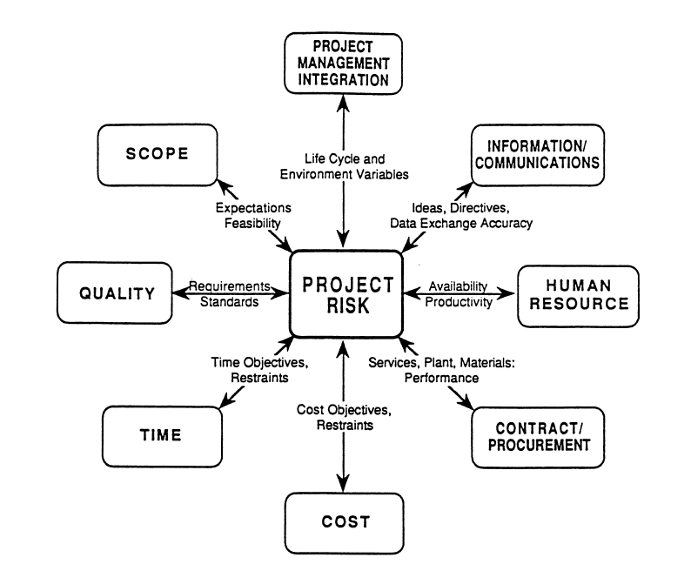
RISK MANAGEMENT
AN INTEGRATIVE FUNCTION
UNIT 4
From Project and Program Risk Management, Max Wideman, PMI
Notes:
RISK MANAGEMENT
AN INTEGRATIVE FUNCTION

Slide 19
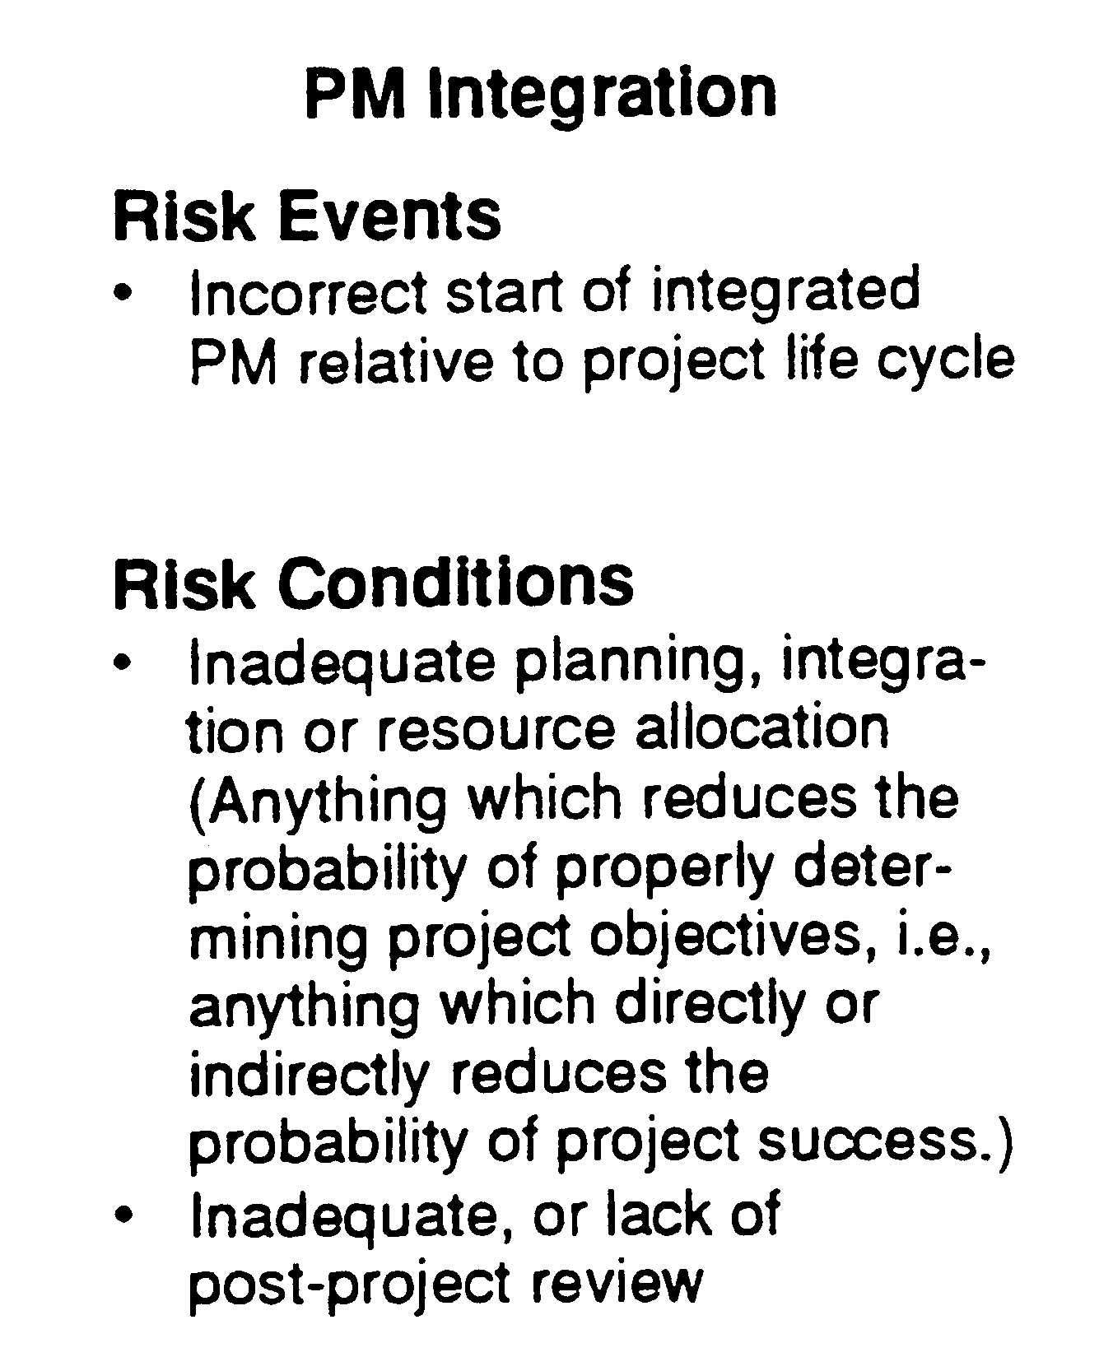
RISK MANAGEMENT
AN INTEGRATIVE FUNCTION
UNIT 4
Typical Functional Distribution of Controllable Risk Items
From Project and Program Risk Management, Max Wideman, PMI
Notes:
RISK MANAGEMENT
AN INTEGRATIVE FUNCTION
Typical Functional Distribution of Controllable Risk Items

Slide 20
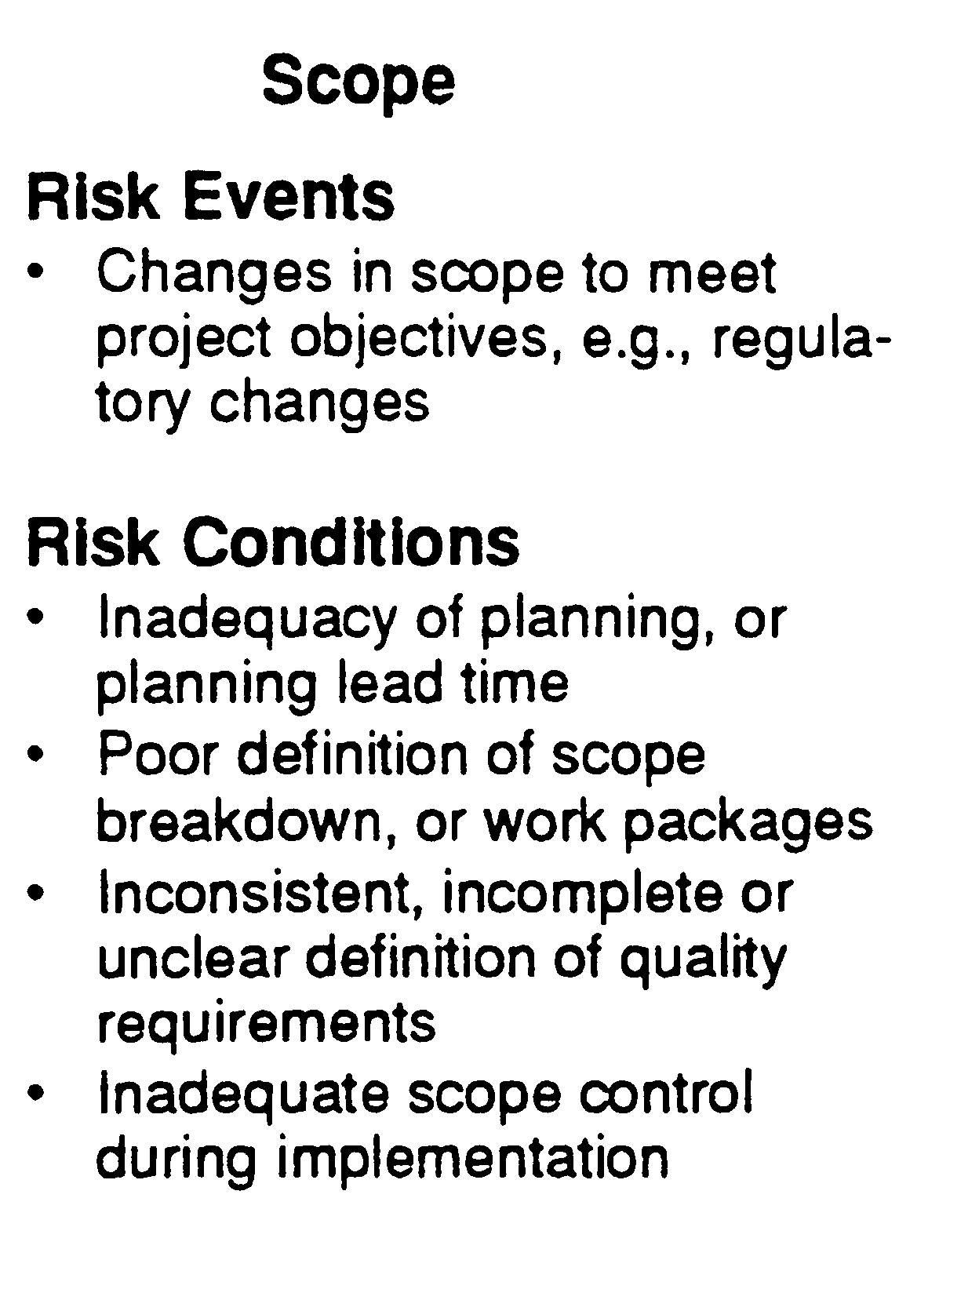
RISK MANAGEMENT
AN INTEGRATIVE FUNCTION
UNIT 4
Typical Functional Distribution of Controllable Risk Items
From Project and Program Risk Management, Max Wideman, PMI
Notes:
RISK MANAGEMENT
AN INTEGRATIVE FUNCTION
Typical Functional Distribution of Controllable Risk Items

Slide 21
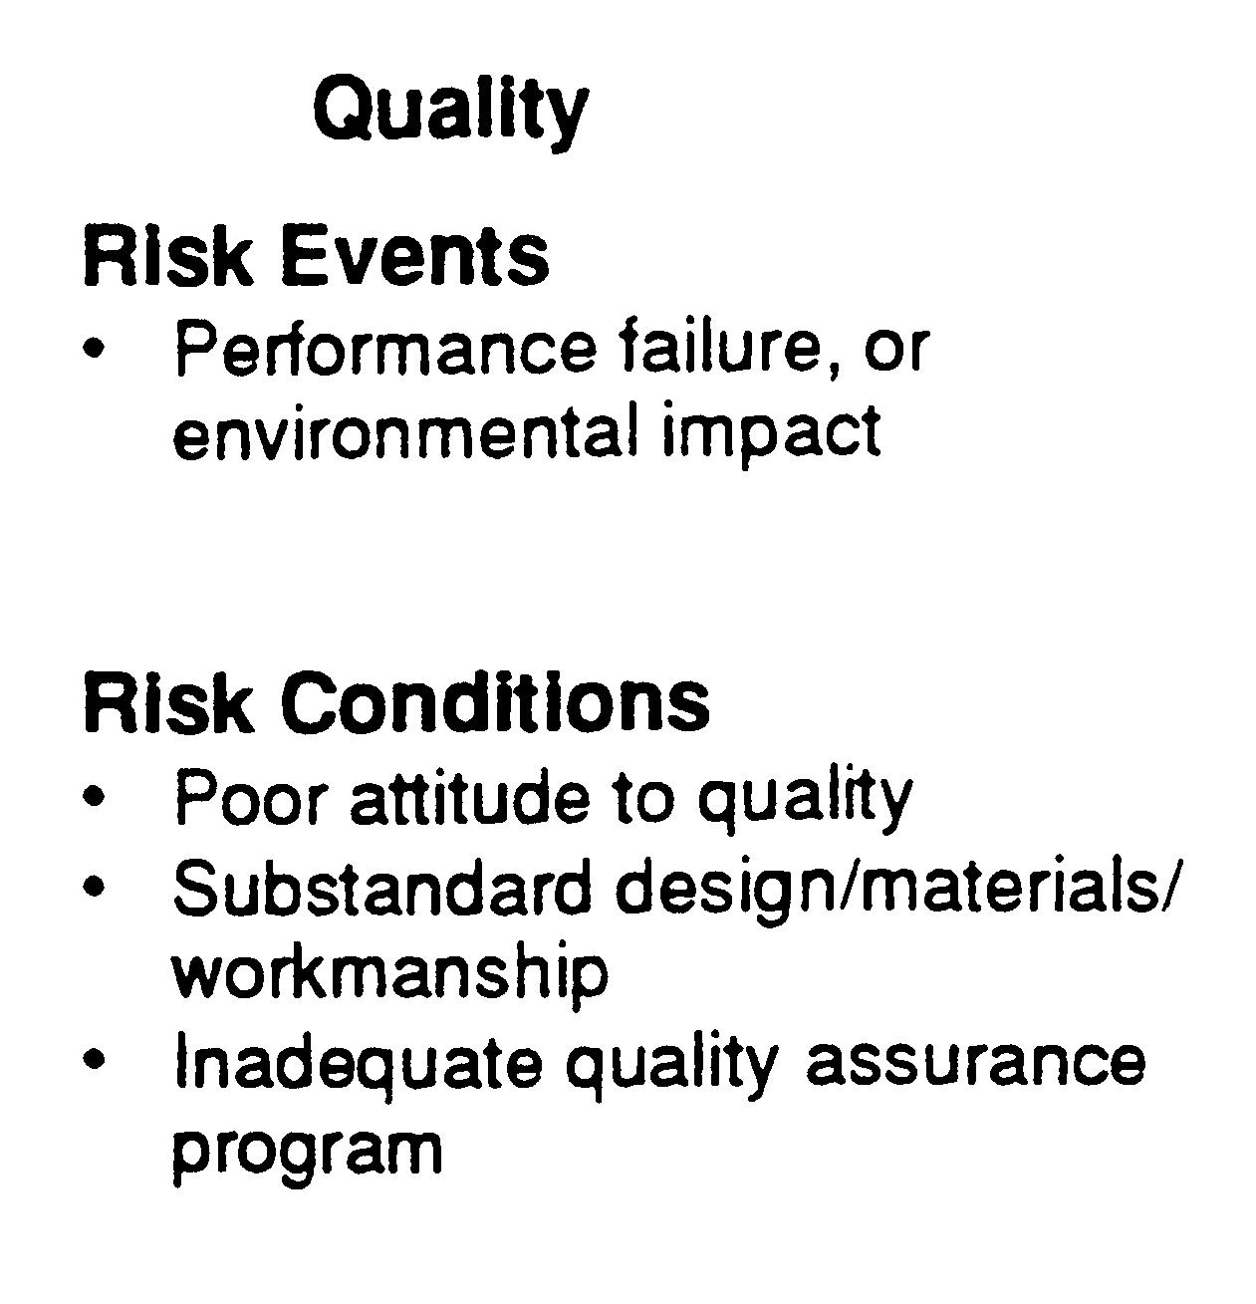
RISK MANAGEMENT
AN INTEGRATIVE FUNCTION
UNIT 4
Typical Functional Distribution of Controllable Risk Items
From Project and Program Risk Management, Max Wideman, PMI
Notes:
RISK MANAGEMENT
AN INTEGRATIVE FUNCTION
Typical Functional Distribution of Controllable Risk Items

Slide 22
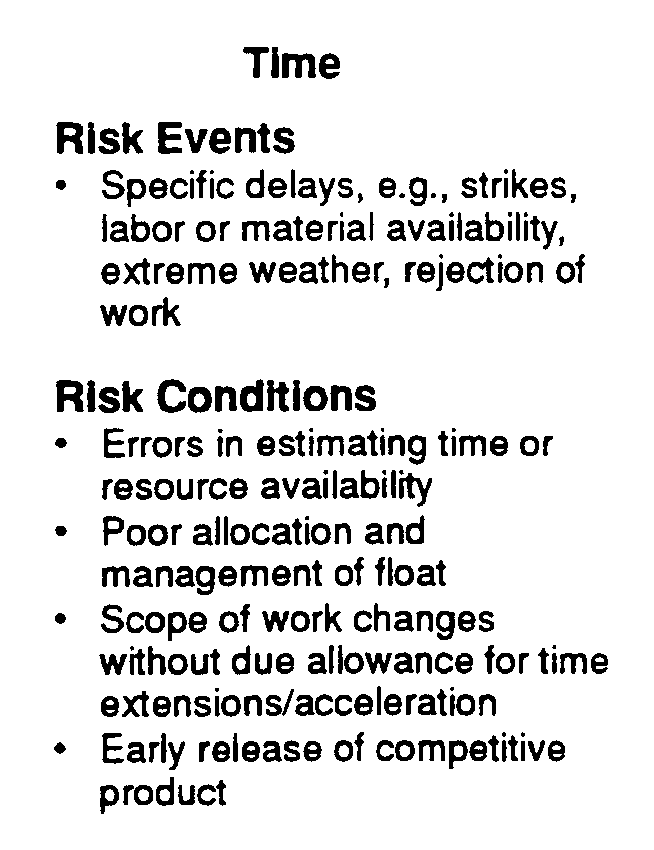
RISK MANAGEMENT
AN INTEGRATIVE FUNCTION
UNIT 4
Typical Functional Distribution of Controllable Risk Items
From Project and Program Risk Management, Max Wideman, PMI
Notes:
RISK MANAGEMENT
AN INTEGRATIVE FUNCTION
Typical Functional Distribution of Controllable Risk Items

Slide 23
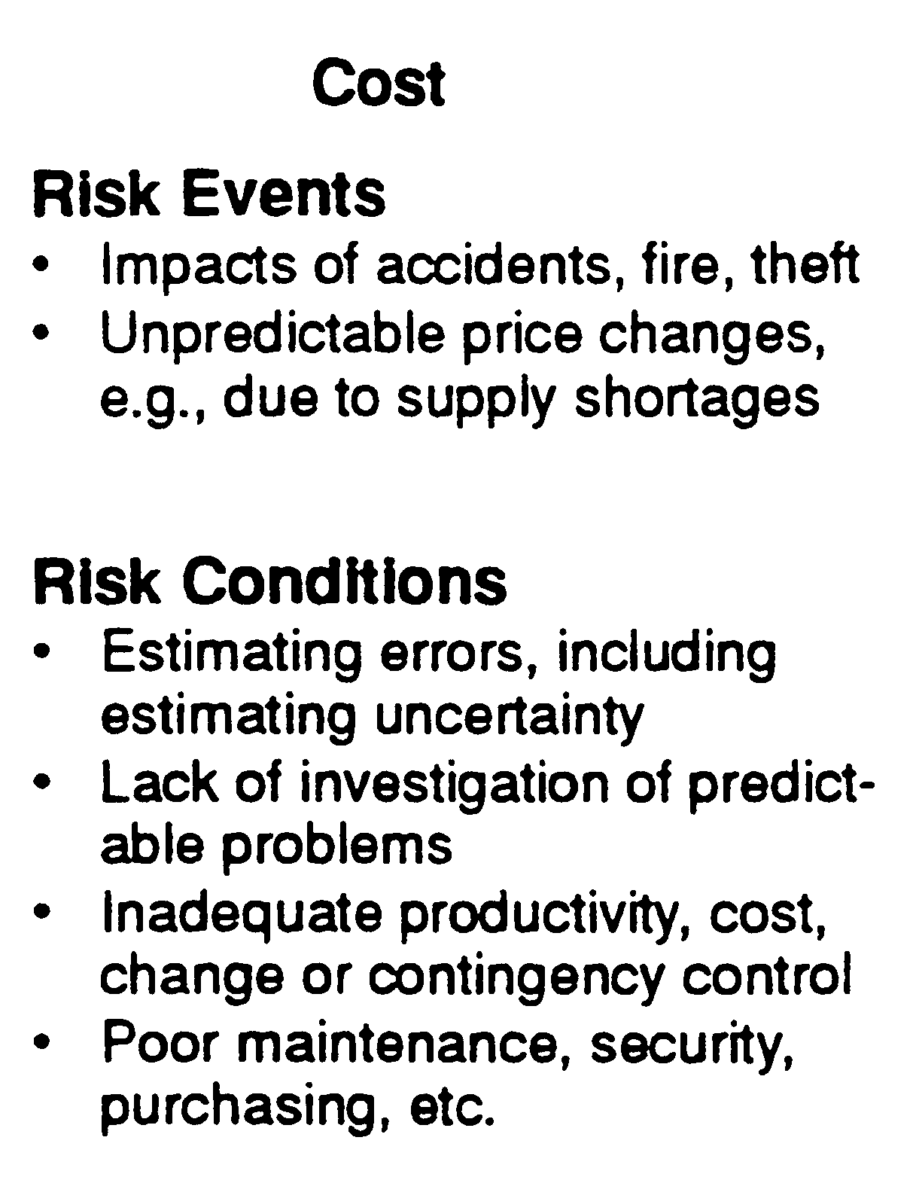
RISK MANAGEMENT
AN INTEGRATIVE FUNCTION
UNIT 4
Typical Functional Distribution of Controllable Risk Items
From Project and Program Risk Management, Max Wideman, PMI
Notes:
RISK MANAGEMENT
AN INTEGRATIVE FUNCTION
Typical Functional Distribution of Controllable Risk Items

Slide 24
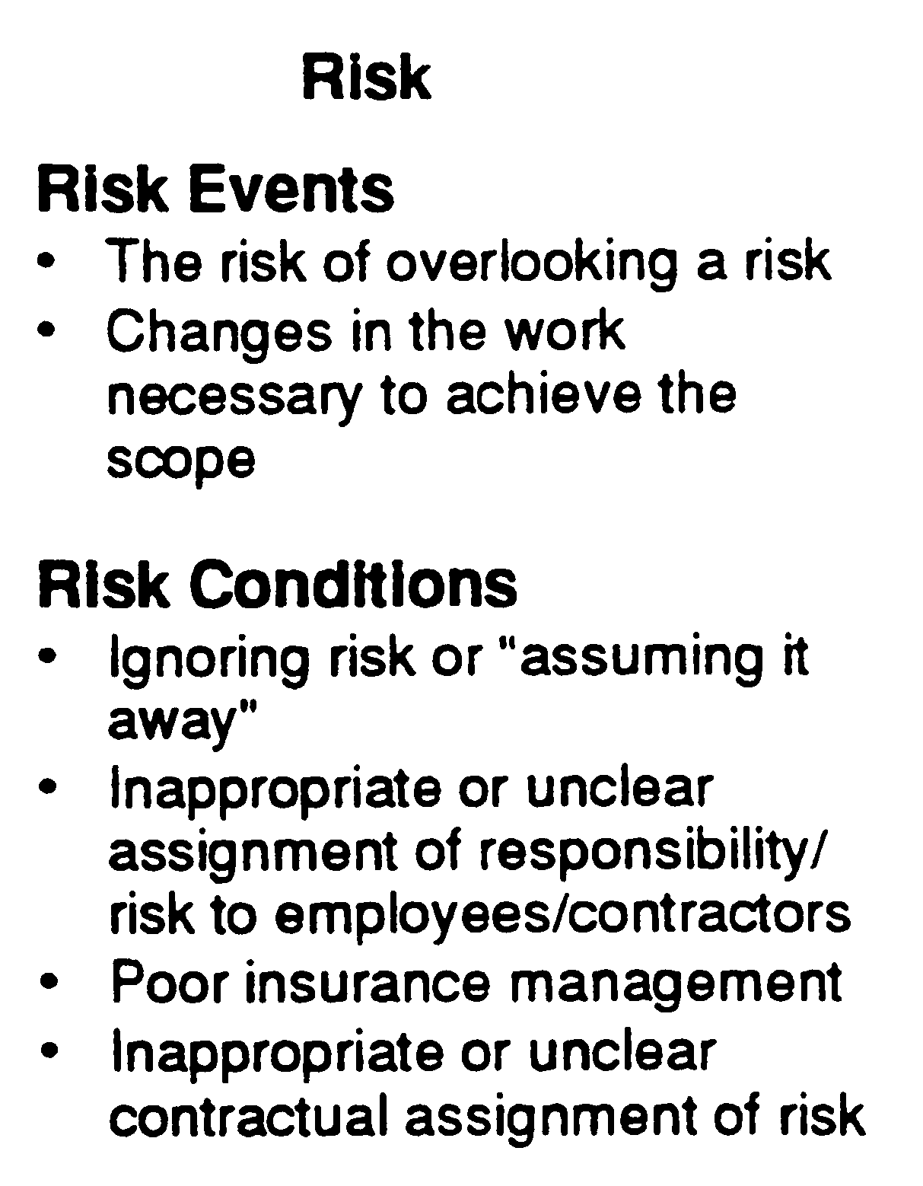
RISK MANAGEMENT
AN INTEGRATIVE FUNCTION
UNIT 4
Typical Functional Distribution of Controllable Risk Items
From Project and Program Risk Management, Max Wideman, PMI
Notes:
RISK MANAGEMENT
AN INTEGRATIVE FUNCTION
Typical Functional Distribution of Controllable Risk Items

Slide 25
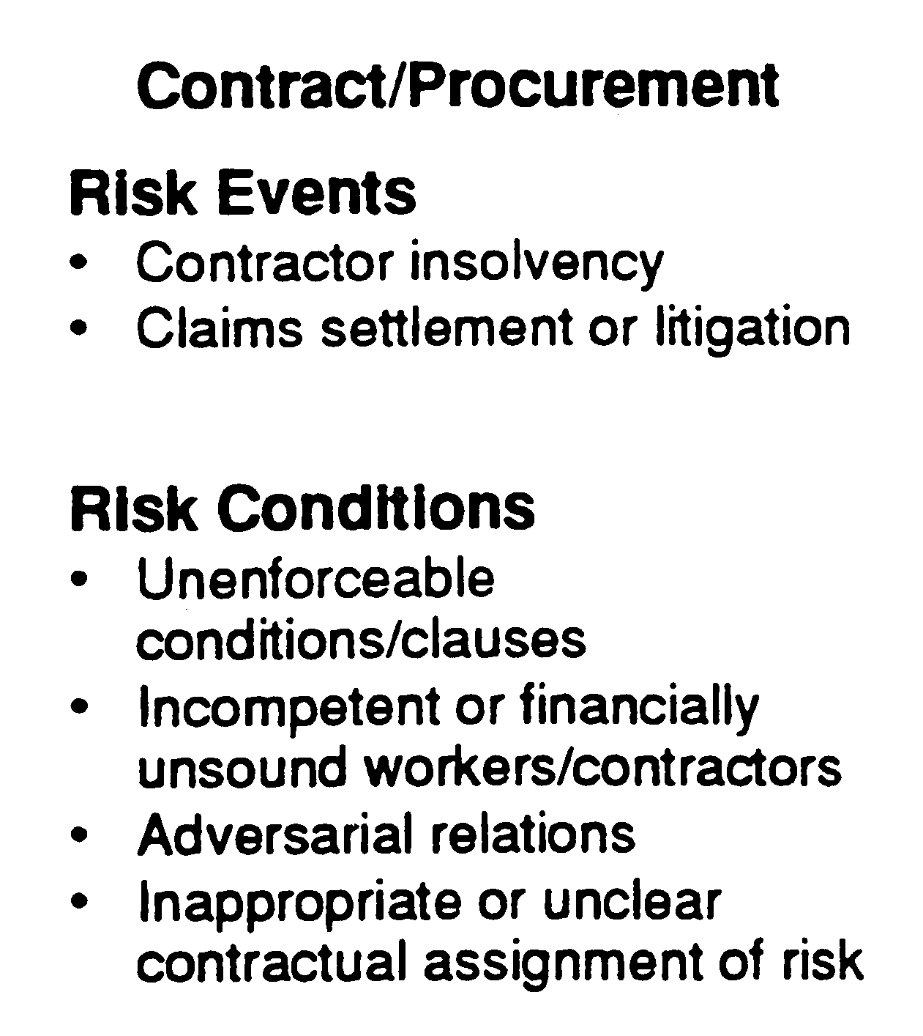
RISK MANAGEMENT
AN INTEGRATIVE FUNCTION
UNIT 4
Typical Functional Distribution of Controllable Risk Items
From Project and Program Risk Management, Max Wideman, PMI
Notes:
RISK MANAGEMENT
AN INTEGRATIVE FUNCTION
Typical Functional Distribution of Controllable Risk Items

Slide 26
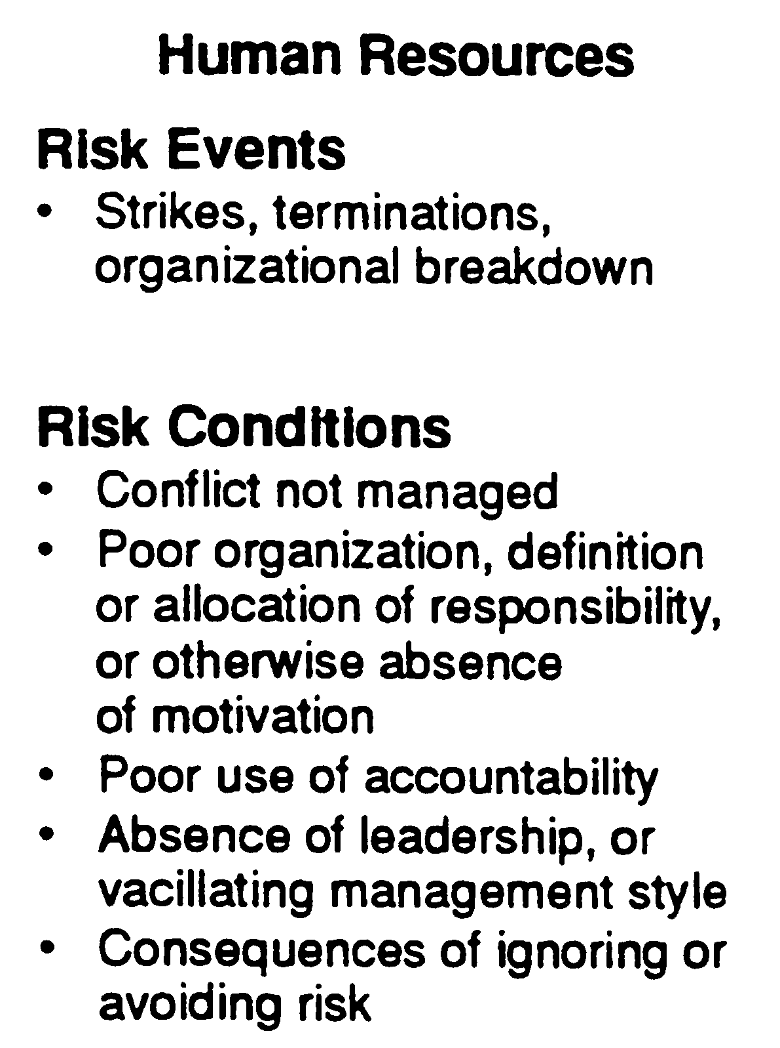
RISK MANAGEMENT
AN INTEGRATIVE FUNCTION
UNIT 4
Typical Functional Distribution of Controllable Risk Items
From Project and Program Risk Management, Max Wideman, PMI
Notes:
RISK MANAGEMENT
AN INTEGRATIVE FUNCTION
Typical Functional Distribution of Controllable Risk Items

Slide 27
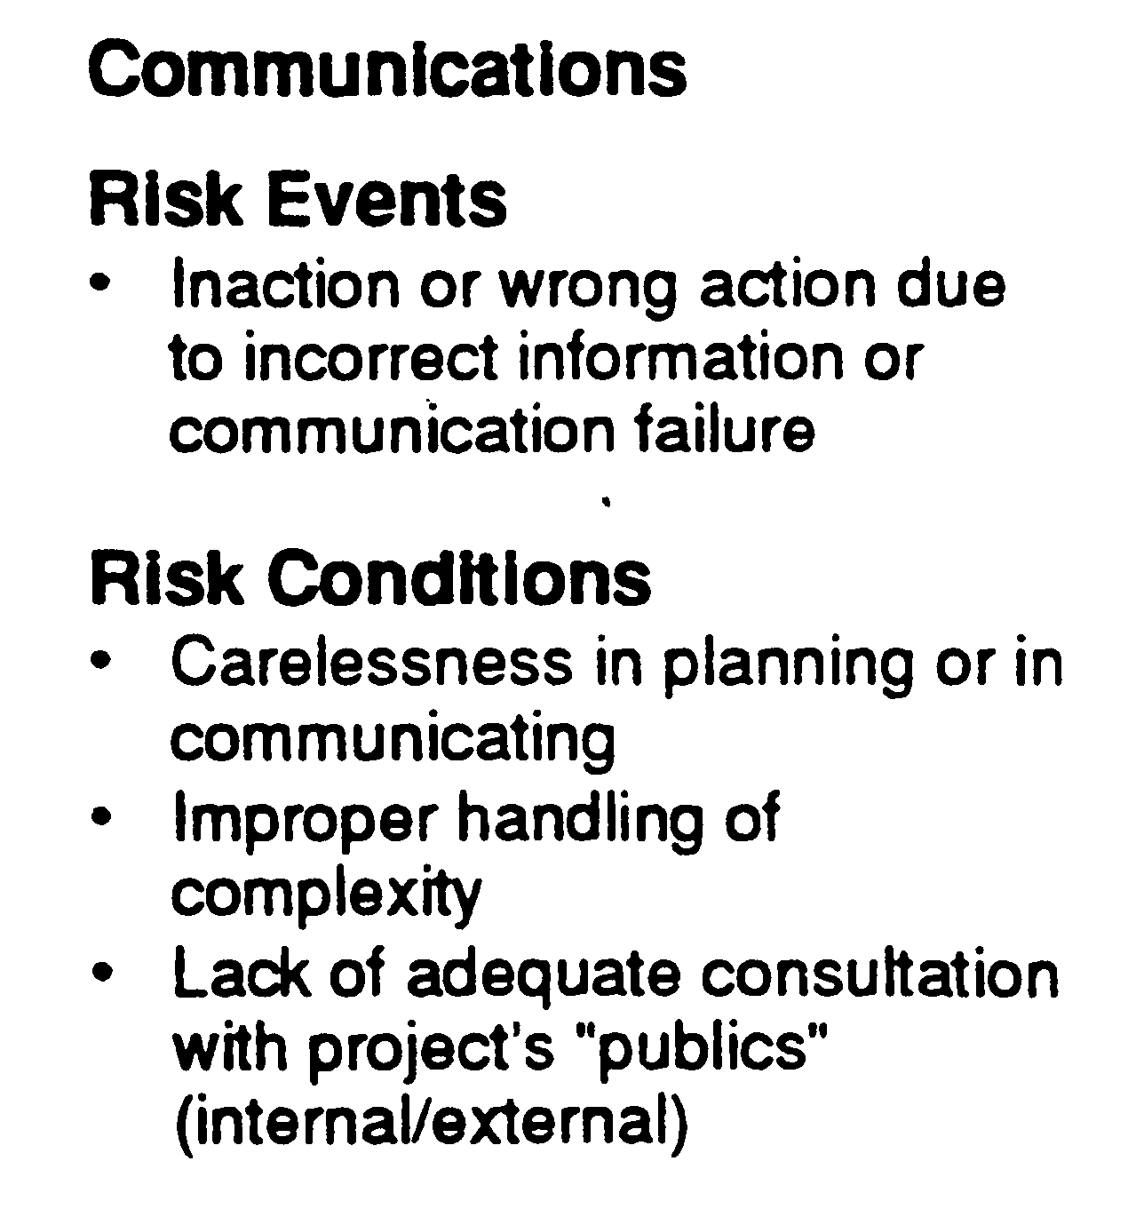
RISK MANAGEMENT
AN INTEGRATIVE FUNCTION
UNIT 4
Typical Functional Distribution of Controllable Risk Items
From Project and Program Risk Management, Max Wideman, PMI
Notes:
RISK MANAGEMENT
AN INTEGRATIVE FUNCTION
Typical Functional Distribution of Controllable Risk Items

Slide 28
STAKEHOLDER
RISK ATTITUDES
UNIT 4
Extent to which an individual risk or overall project risk matters.
A wide range of factors influence risk attitude.
Scale of the project within the range of stakeholders’ overall activities.
Strength of public commitment made about the performance of the project.
Stakeholders’ sensitivity to issues like:-
Environmental impacts
Industrial relations
From Practice Standard for Project Risk Management, 1st Ed, PMI
Notes:
STAKEHOLDER
RISK ATTITUDES
Extent to which an individual risk or overall project risk matters.
A wide range of factors influence risk attitude.
Scale of the project within the range of stakeholders’ overall activities.
Strength of public commitment made about the performance of the project.
Stakeholders’ sensitivity to issues like:-
Environmental impacts
Industrial relations

Slide 29
STAKEHOLDER
RISK ATTITUDES
UNIT 4
Usually result in a desire for increased certainty in project outcomes.
May express a preference for one project objective over another.
Strongly influenced by organizational culture.
Depends how open an organization is.
Risk attitudes must be identified and managed proactively and deliberately throughout the project Risk Management process.
May differ from project to project for the same stakeholder.
International, cross-industry, or multi-organizational teams.
From Practice Standard for Project Risk Management, 1st Ed, PMI
Notes:
STAKEHOLDER
RISK ATTITUDES
Usually result in a desire for increased certainty in project outcomes.
May express a preference for one project objective over another.
Strongly influenced by organizational culture.
Depends how open an organization is.
Risk attitudes must be identified and managed proactively and deliberately throughout the project Risk Management process.
May differ from project to project for the same stakeholder.
International, cross-industry, or multi-organizational teams.

Slide 30
VARIATIONS OF
RISK FACTORS
UNIT 4
Project Risk Factors are also subject to considerable change during Project Life Cycle.
Four generic phases of a typical Project
Concept - Project Planning
Development- Project Planning
Implementation-Realization/Accomplishment
Termination- Realization/Accomplishment
Opportunity and Risk remain high during Project Planning
Amount at stake remains low during Planning.
From Project and Program Risk Management, Max Wideman, PMI
Notes:
VARIATIONS OF
RISK FACTORS
Project Risk Factors are also subject to considerable change during Project Life Cycle.
Four generic phases of a typical Project
Concept - Project Planning
Development- Project Planning
Implementation-Realization/Accomplishment
Termination- Realization/Accomplishment
Opportunity and Risk remain high during Project Planning
Amount at stake remains low during Planning.

Slide 31
FOUR-PHASE APPROACH
UNIT 4
Four Process Phases
Identification
Assessment
Response
Documentation
From Project and Program Risk Management, Max Wideman, PMI
Notes:
FOUR-PHASE APPROACH
Four Process Phases
Identification
Assessment
Response
Documentation

Slide 32
ITERATIVE PROCESS
Why?
UNIT 4
Circumstances change as projects are being planned and executed.
Amount of information available about risk usually increase as time goes on.
Some risk will occur while others will not.
New risks will arise or be discovered.
Characteristics of those already identified may change.
Project Risk Management processes should be repeated and the corresponding plans progressively elaborated throughout the lifetime of the project.
From Practice Standard for Project Risk Management, 1st Ed, PMI
Notes:
ITERATIVE PROCESS
Why?
Circumstances change as projects are being planned and executed.
Amount of information available about risk usually increase as time goes on.
Some risk will occur while others will not.
New risks will arise or be discovered.
Characteristics of those already identified may change.
Project Risk Management processes should be repeated and the corresponding plans progressively elaborated throughout the lifetime of the project.

Slide 33
ITERATIVE PROCESS
What?
UNIT 4
The identification and analysis of risks should be revisited periodically.
The progress on risk response actions should be monitored.
Action Plans should be accordingly adjusted.
It may also be necessary to revisit the Risk Management Planning Process.
Developing an initial risk management plan and risk assessment is the start of the process, not the end.
From Practice Standard for Project Risk Management, 1st Ed, PMI
Notes:
ITERATIVE PROCESS
What?
The identification and analysis of risks should be revisited periodically.
The progress on risk response actions should be monitored.
Action Plans should be accordingly adjusted.
It may also be necessary to revisit the Risk Management Planning Process.
Developing an initial risk management plan and risk assessment is the start of the process, not the end.

Slide 34
ITERATIVE PROCESS
Frequency and Depth
UNIT 4
The frequency and depth of reviews and updates will depend on
The nature of the project.
The volatility of the environment in which the project is being implemented.
The timing of other project management reviews and updates.
From Practice Standard for Project Risk Management, 1st Ed, PMI
Notes:
ITERATIVE PROCESS
Frequency and Depth
The frequency and depth of reviews and updates will depend on
The nature of the project.
The volatility of the environment in which the project is being implemented.
The timing of other project management reviews and updates.

Slide 35
COMMUNICATION
In Risk Management
UNIT 4
Cannot take place in isolation.
Success relies heavily on communication throughout the process.
Comprehensive input from stakeholders to ensure:-
Nothing significant is overlooked
Risks are realistically assessed
Credibility of the process and Commitment of those who manage risks can only be ensured by:
The way the process operates
Conclusions it produces
From Practice Standard for Project Risk Management, 1st Ed, PMI
Notes:
COMMUNICATION
In Risk Management
Cannot take place in isolation.
Success relies heavily on communication throughout the process.
Comprehensive input from stakeholders to ensure:-
Nothing significant is overlooked
Risks are realistically assessed
Credibility of the process and Commitment of those who manage risks can only be ensured by:
The way the process operates
Conclusions it produces

Slide 36
COMMUNICATION
In Risk Management
UNIT 4
Effective and honest communication with
The rest of the project team
Other project stakeholders
Communications of results must meet specific stakeholders needs and expectations reflected in project communication strategy.
Role and Responsibility of each stakeholder must be identified and agreed-upon.
From Practice Standard for Project Risk Management, 1st Ed, PMI
Notes:
COMMUNICATION
In Risk Management
Effective and honest communication with
The rest of the project team
Other project stakeholders
Communications of results must meet specific stakeholders needs and expectations reflected in project communication strategy.
Role and Responsibility of each stakeholder must be identified and agreed-upon.

Slide 37
RESPONSIBILITY OF
Project Risk Management
UNIT 4
Risk Management is Everyone’s Responsibility
Management of risks should not be left to few risk specialists.
Project Risk Management – An integral part of all other project processes.
Each project risk can affect project objectives.
Specific roles depend upon the stakeholder placing and relationship to project objectives.
Roles and Responsibilities of Project risk must be clearly defined and communicated.
Individuals should be held responsible and accountable for results.
Risk Related lessons are captured for future use.
From Practice Standard for Project Risk Management, 1st Ed, PMI
Notes:
RESPONSIBILITY OF
Project Risk Management
Risk Management is Everyone’s Responsibility
Management of risks should not be left to few risk specialists.
Project Risk Management – An integral part of all other project processes.
Each project risk can affect project objectives.
Specific roles depend upon the stakeholder placing and relationship to project objectives.
Roles and Responsibilities of Project risk must be clearly defined and communicated.
Individuals should be held responsible and accountable for results.
Risk Related lessons are captured for future use.

Slide 38
PROJECT MANAGER’S ROLE
for Project Risk Management
UNIT 4
Encouraging senior management support for Project Risk Management activities.
Determining the acceptable levels of risk for the project in consultation with stakeholders.
Developing and approving the risk management plan.
Promoting the Project Risk Management process for the project.
Facilitating open and honest communication about risk within the project team and with management and other stakeholders.
From Practice Standard for Project Risk Management, 1st Ed, PMI
Notes:
PROJECT MANAGER’S ROLE
for Project Risk Management
Encouraging senior management support for Project Risk Management activities.
Determining the acceptable levels of risk for the project in consultation with stakeholders.
Developing and approving the risk management plan.
Promoting the Project Risk Management process for the project.
Facilitating open and honest communication about risk within the project team and with management and other stakeholders.

Slide 39
PROJECT MANAGER’S ROLE
for Project Risk Management
UNIT 4
Participating in all aspects of the Project Risk Management process.
Approving risk responses and associated actions prior to implementation.
Applying project contingency funds to deal with identified risks that occur during the project.
Overseeing risk management by subcontractors and suppliers.
Regularly reporting risk status to key stakeholders, with recommendations for appropriate strategic decisions and actions to maintain acceptable risk exposure.
From Practice Standard for Project Risk Management, 1st Ed, PMI
Notes:
PROJECT MANAGER’S ROLE
for Project Risk Management
Participating in all aspects of the Project Risk Management process.
Approving risk responses and associated actions prior to implementation.
Applying project contingency funds to deal with identified risks that occur during the project.
Overseeing risk management by subcontractors and suppliers.
Regularly reporting risk status to key stakeholders, with recommendations for appropriate strategic decisions and actions to maintain acceptable risk exposure.

Slide 40
PROJECT MANAGER’S ROLE
for Project Risk Management
UNIT 4
Escalating identified risks to senior management where appropriate
Outside the authority and control of project manager
Requiring input/action from outside of project
Release of management funds might be appropriate.
Monitoring the efficiency and effectiveness of the Project Risk Management process.
Auditing risk responses for their effectiveness and documenting lessons learned.
From Practice Standard for Project Risk Management, 1st Ed, PMI
Notes:
PROJECT MANAGER’S ROLE
for Project Risk Management
Escalating identified risks to senior management where appropriate
Outside the authority and control of project manager
Requiring input/action from outside of project
Release of management finds might be appropriate.
Monitoring the efficiency and effectiveness of the Project Risk Management process.
Auditing risk responses for their effectiveness and documenting lessons learned.

Slide 41
UNIT 4
Review Questions

Slide 42
The End
THE END
THANK YOU

